Slide 1


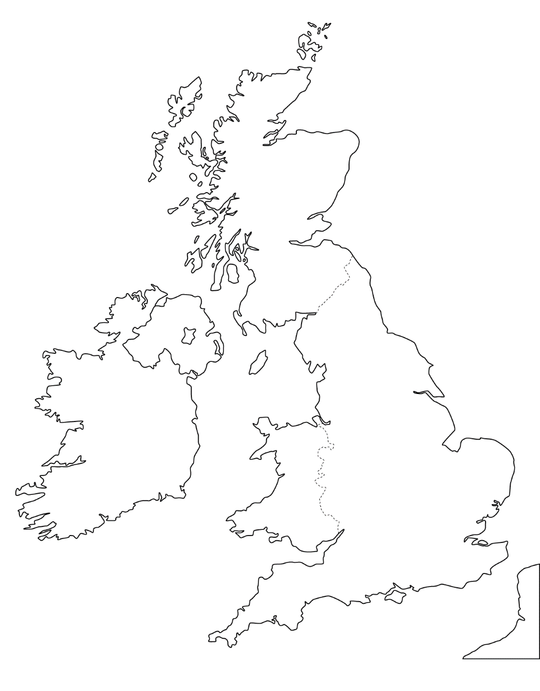
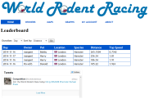













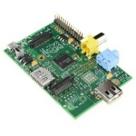





Asleep at the wheel
Europe
Edinburgh
php-to-Gaian
(First of a kind)
America
MySQL
Belfast
Manchester
IBM GaianDB
Cardiff
London
America
What we’ve built
Europe
GaianDB
Our distributed GaianDB

